Slide 1
TB Updates and Outbreaks 2018
Brenda Earles RNBN CIC
May 2018
May

Slide 2
Objectives
TB – the disease
Elimination Goals
TB – history in Labrador
Hopedale Outbreak & Outbreak Management
Barriers to Control
Local Initiatives
Current Investigations

Slide 3
What is TB?
Disease caused by Mycobacterium Tuberculosis
Treatable and curable
Usually affects the lungs
Other names
TB
Consumption
Wasting disease

Slide 4
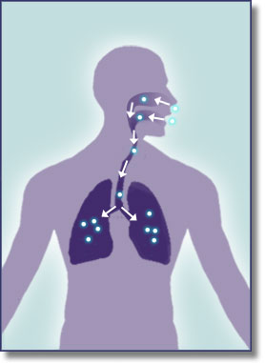
TB Transmission
Spread by airborne route; droplet nuclei
Transmission affected by
Infectiousness of patient
Environmental conditions
Duration of exposure
Most exposed persons do not become infected

Slide 5
Pathogenesis in an infected host

Slide 6
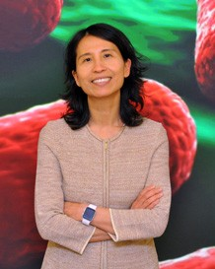
Spotlight on Eliminating TB in the North
Dr. Theresa Tam,
CMOH Canada
As this report makes clear, social determinants of health
such as:
poverty, food insecurity, inadequate housing and overcrowding contribute to health inequity and are significant underlying risk factors for TB.
Canada is committed to meeting the WHO goal of reaching less than one TB case per 100,000 by 2035
Notes:
Tuberculosis (TB) is the epitome of inequity in public health; it is a social disease with a medical aspect.”
current momentum to eliminate TB coming from the force of leadership within Inuit communities. TB rates are almost 300 times higher among Inuit than for the Canadian born non-Indigenous population.

Slide 7
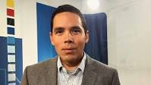
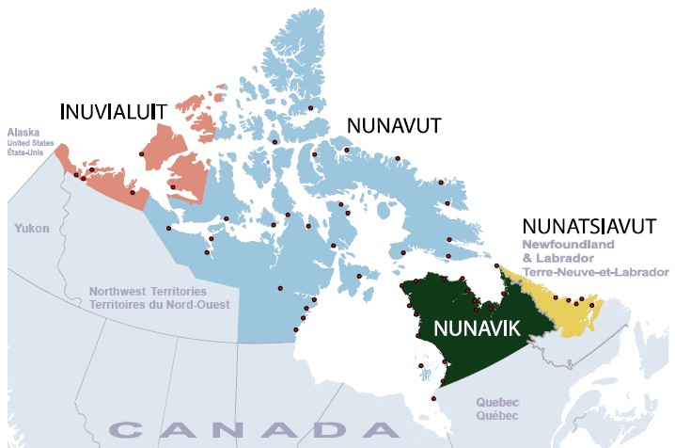
Nathan Obed
"If we start with this idea that we can eliminate TB in Inuit Nunangat, then I hope that other things will follow because you can't look at this issue…without thinking that we need to do something about overcrowding or social conditions."
Inuit Tapiriit Kanatami
Notes:
President of Inuit Tapiriit Kanatami

Slide 8
TB in Canada

Slide 9
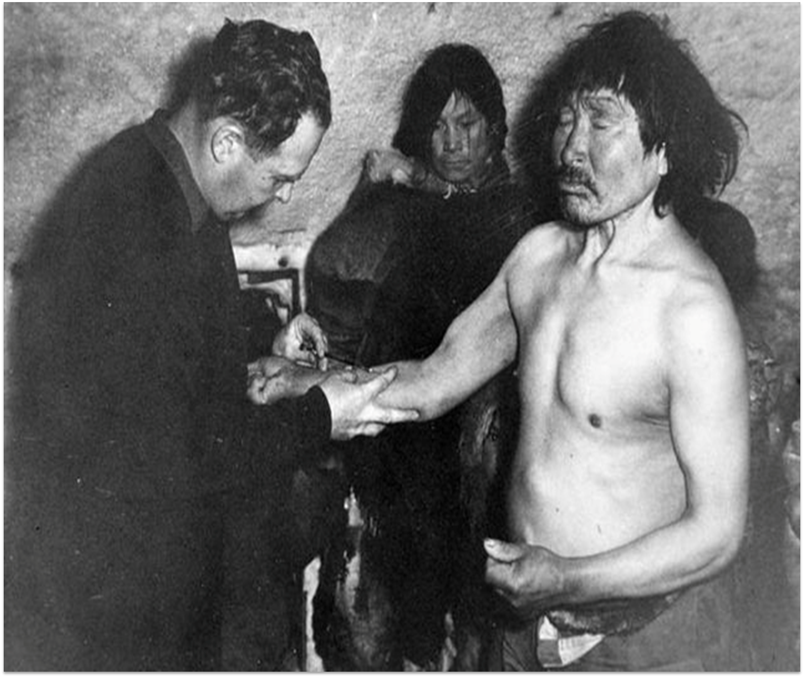
History of TB in the North
TB was first brought to Inuit by whalers and explorers in the early 20th century
“For Inuit, the history of TB is part of the history of colonization” - ITK 2008
As with other circumpolar areas Labrador coast was served by ships making TB diagnoses and taking active cases away for treatment (the Seal)
An intrusive and disruptive history that impacts care, communities and families to this day
Inpatient care provided in St Anthony and NWR far from peoples homes and family
Notes:
Circumpolar peoples and Arctic peoples are umbrella terms for the various indigenous peoples of the Arctic.
The CD Howe: In the 1940s ships such as the CD Howe or "hospital boats" were used in the Eastern Arctic Patrol to test and evacuate Inuit with TB.^{Footnote 13} If found ill, the letters "TB" were printed on the patient's hand and they were transported to provincial hospitals in the South and sanatoria for treatment sometimes only hours after diagnosis.^{Footnote 13}The forcible removal of people (even children and infants) from their families and loved ones resulted in great emotional distress and, in some cases, hindered the survival of those at home

Slide 10
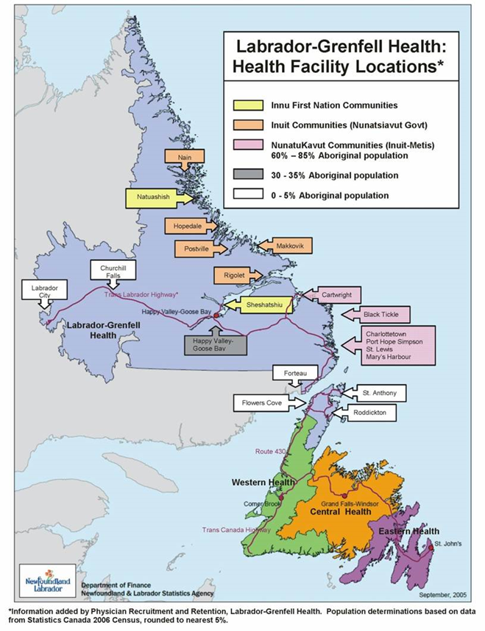
Labrador Grenfell Health Region
Notes:
Inuit communities in pink

Slide 11
LGH Outbreaks
Two independent outbreaks (2014-2015)
Nain
Happy Valley Goose Bay (HVGB)
Outbreak 2016
Hopedale
Activity in Natuashish, Sheshashiu, St. Anthony, Cartwright & HVGB
Currently investigating cluster in Nain
Notes:
# cases: 27 Cases in Nain , 11 Cases in HVGB 10 Hopedale ( July 2017)

Slide 12
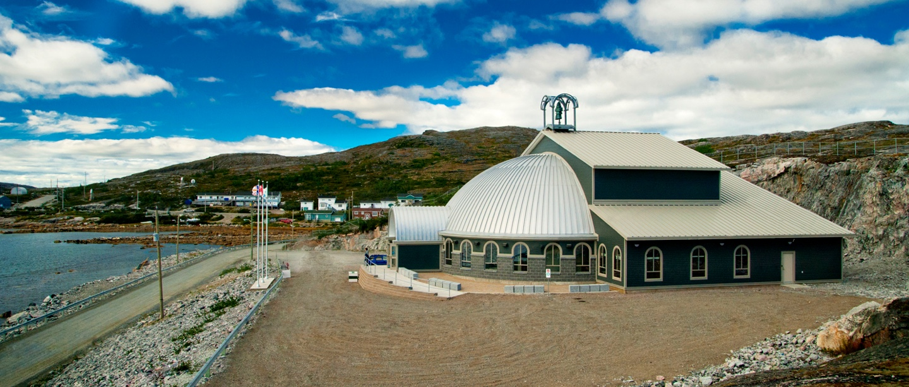
Hopedale –Arvertok (place of whales)
Population of 567, 83% of the population identify as Inuit
Renamed to Hopedale by Moravian Missionaries arriving from Germany in 1782.
Hopedale is the legislative capital of the Nunatsiavut Government

Slide 13
Social Risk Factors
Poor Housing - Aboriginal Canadians 8 times more likely to live in overcrowding
70% of Inuit smoke (55% Nunatsiavut)
Food insecurity
Poor access to continuous primary health care
Substance abuse
Notes:
Housing
Between 9-16% of homes in Nunatsiavut are overcrowded (>20% Nain and Hopedale)
38% house multiple family units
44% have mould
Food Insecurity
70% of Inuit preschoolers living in food insecure households
18% households had an adult not eating for a day due to $
13% household had a child not eat for a day due to $
2007-2008 Inuit Health Survey
Many Medical conditions associated with progression to TB disease

Slide 14
Outbreak in Hopedale
Activity in Natuashish, Sheshashiu, St. Anthony, Cartwright & HVGB
Notes:
Cases were young – 15-24 yrs 9 cases total. WE actually ended up with 14 cases in 2016 and 3 more cases in 2017 So far we have had 17 cases. Cases can be connected as far as 2 years out.

Slide 15
Incidence
Incidence is a measurement of the number of new individuals who contract a disease during a particular period of time.
Location | Incidence Rate
Hopedale | 2469.1 per 100,000 (2016)
Labrador Grenfell Health | 59.0 per 100,000 ( 2016)
NL | 4.7 per 100,000 (2016)
Canada | 4.4 per 100,000 (2014)
Haiti | 194 per 100,000 ( 2015)
Notes:
Prevalence is a measurement of all individuals ( new cases plus old cases) affected by the disease at a particular time, Hopedale Incidence rate is so high because of small population

Slide 16
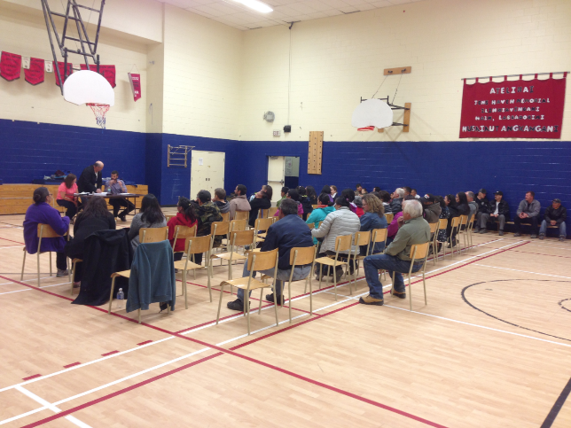
Response
Outbreak management team initiated – NG, LGH,
Dept. Health and PHL
CDCN devoted to TB follow up only
Extra TB Clinics
Community meeting with Dr. Woollam, MOH, CDCN and NG Minister of Health and NG Director Health and NG community public health team
Social Risk factors identified:
“TB is a social Disease with a medical aspect”
Dr. William Osler

Slide 17
Contact Tracing
# contacts a case can have
Index case
Identify Contact : person exposed to an active case of TB. 2nd priority of TB program
Prioritize contacts - interview , TST testing
Objectives : identify and treat secondary cases, detect & treat LTBI, source case and treatment if index case under 5
Notes:
a source case is identified in less than half of investigations

Slide 18
Social Network of TB in Hopedale
Notes:
Red case , Blue people known , green unknown Visually show who has contact with who. Another way to use is by place. 15 small contact list .Average 51 peoples if school involved 93.

Slide 19
Challenges
Long turn around times for sputum analysis
Insufficient sputums
Geographic isolation of healthcare services
Transportation of patients
Substance abuse
Compliance issues
Notes:
Hydro, NL Housing, Air Lab, LCC, Supportive Living Staff, Circuit court

Slide 20
Steps to Overcoming Challenges
Sputums
PHN collect first sample
Sputum samples are shipped directly to PHL from communities
Portable Negative pressure unit
Access to Health Care Services/Transportation
Same day fly in-fly out TB Clinics
Public Concerns
Added TB Assessment clinics
Education Sessions for Community
Notes:
Carried over from Nain Outbreak

Slide 21
Steps to Overcoming Challenges
Public Concern Cont’d.
Public meeting
Public messaging
Distribution of TB pamphlets
TB campaign .
Compliance
Home delivery of DOT
Personal Incentives
Notes:
Substance Abuse
Nunatsiavut and LGH partnering to develop outreach program

Slide 22
Current Cluster Investigation in Nain
1st case March 2018 youth
2nd case child
Late March Tripartite Government Initiative formed
Implementation committee
Clinical committee
Support form NML , Ness and FINHB

Slide 23
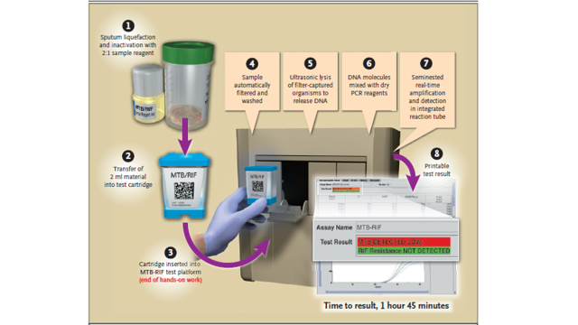
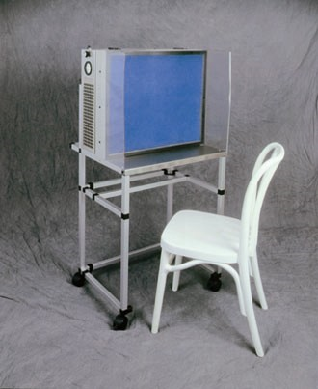
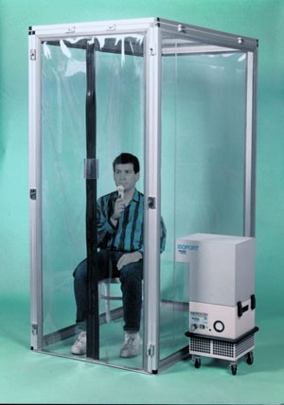
New Diagnostic Tools
Portable x-ray
GeneXpert
Sputum induction tent
current proposed

Slide 24
New Treatment for LTBI
Rifapentine/ ISONIAZID: 12 dose Treatment for latent Tuberculosis
Once a week for 12 weeks
Special access
Currently a shortage
Using in Nain for the current cluster.

Slide 25
TB Awareness Day
Notes:
Had in each community and in HV to homeless shelters. Excellent uptake and attendance

